Slide 1

Test Suite Application
Department of Computer Science
Software Engineering
Team: Paradigm
Presented by
Cavaughn Browne
Cristian Norfleet
Damien Moeller
Aimee Phillips

Slide 2
Outline
Overview / Scenario
Introduction
System Design
Demo of Product
Product Pros and Cons
Bugs/Known Issues
Team Organization
Different Approach
Future Extensions
Conclusion

Slide 3

Overview
Students often have problems with testing their programs. They currently submit programs without proper testing due to lack of knowledge of testing methods and tool-sets. Although the program might seem functional, the students may overlook possible faults and develop bad habits. This program will aid said students by parsing code and generating applicable test cases and test drivers as well as generating test reports for use and review.

Slide 4
Introduction
What is the applications Purpose/Goals?
Built to assist lower level CMPS students
Test Programs for unexpected output and exception handling
Reads Source Code files and Creates appropriate test data and test cases for input source file code
Saves Report for review
Compares hand written and program results

Slide 5
System Design
Windows application coded in C#
Using Iron Python 2.7 to parse source code
Users open source code and inputs are displayed in List boxes on the GUI
Users can configure their tests, generate tests, save report, load and save configurations by clicking buttons.
Functionality to compare expected results with actual results

Slide 6
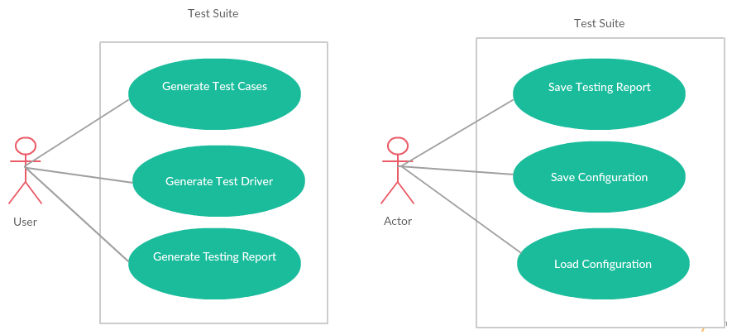
System Design – Use Case Diagram

Slide 7
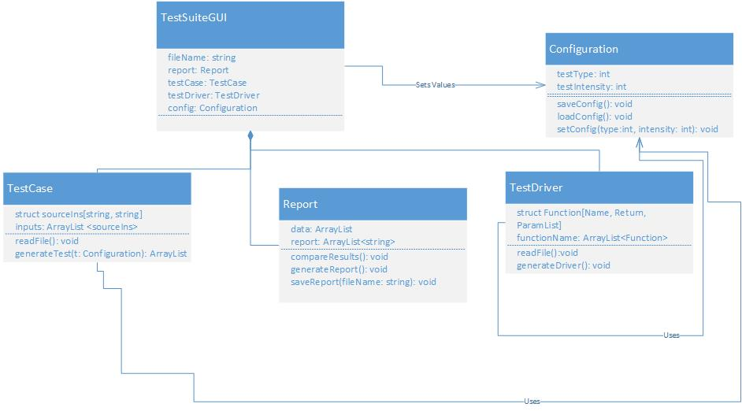
System Design – Class Diagram

Slide 8
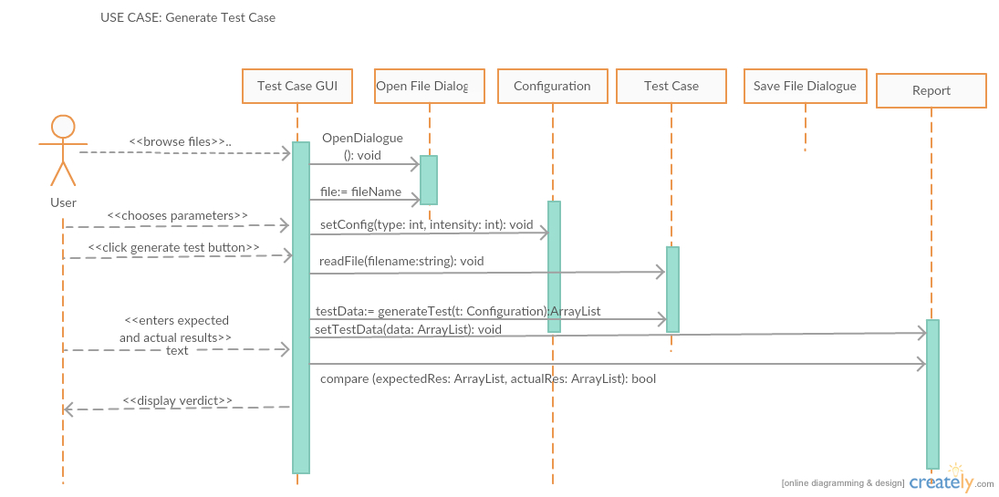
System Design – Sequence Diagram

Slide 9
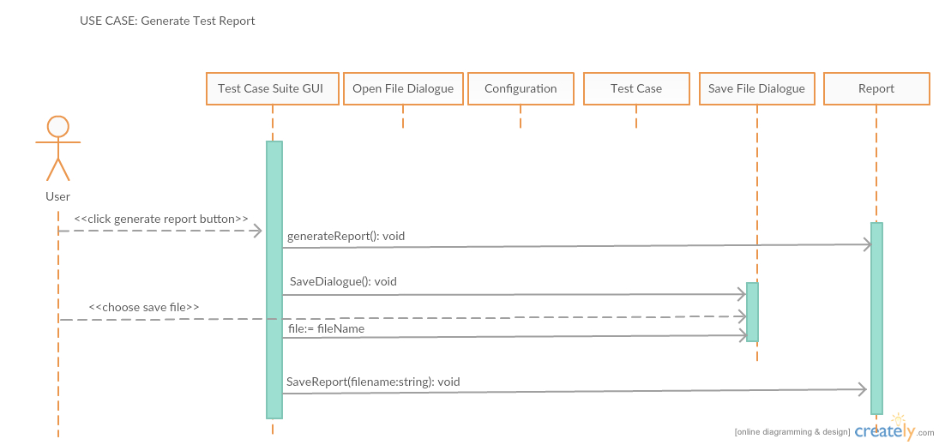
System Design – Sequence Diagram 2

Slide 10
System Design – New Class Diagram

Slide 11
Demo

Slide 12
Pros and Cons
Pros
User-friendly interface (GUI)
Fast Test Generation
Generation of Report for later review or use
Comprehensible and well labeled Tables / Buttons
Built in result comparison for hand written results and program results
Variety of selections
Testing options / Levels

Slide 13
Pros and Cons
Cons / Known Issues
Tables can be hard to understand at times
Level 2 and 3 Boundary testing does the same thing
Issue where if check boxes are switched too quickly the generate button won’t be enabled or disabled correctly
Menu items to run tests aren’t disabled along with their corresponding button
File types are not restricted to their appropriate tests (.h files should only be able to do O-O testing)

Slide 14
Pros and Cons
Other Issues Observed…
Only supports inputs from getlines and >> as well as inputs that have their declarations on the same line as the type
Inputs that are commented are also retrieved when parsing
If the .h file has any private methods or functions outside of the class, the driver will not generate correctly
More than one user manual cannot be opened at a time. Will throw an exception.

Slide 15
Deviations from Requirements
GUI differed from requirements
Includes inputs for boundary testing ( Upper and Lower Limits ), instead of solely analyzing the source file as intended
Method of handling the parsing of strings
Python Library / Scripts used rather than implementing in C# as intended
Current classes differ from original class diagram
Default PDF reader requirement not stated
Required when opening user manual from program

Slide 16
Deployment Issues
Product must work on target environment
Recent Windows Operating Systems
Handling problems with permissions and where files are placed on the user’s system
All dependencies must be packaged with product
DLLs, input files, other files, etc
Make Installation as easy as possible

Slide 17
Team Organization
Principles from Agile Processes
Egoless Team Structure
Democratic and decentralized
Tasks needed to be done were taken on and chosen by the team member based on their skills and time availability
Kept on track with group chat over Slack
Documents shared over GitHub
Frequent Meetings in person / in class (if available) / Over the internet (Google Hangout)

Slide 18
Different Approach
If more time permitted…
More testing on certain functions
Make tables more distinguished
More language support and threading
Implemented the other 3 testing methods
Better version management / better planning

Slide 19
Future Extensions
Extend to reading more languages / Certain language options grayed out for future implementation
Only C++ source code can be selected currently
Future languages to be implemented include Java, C# and Python
Extended to do Path, Functional and Loop testing
The three implemented right now are Object-Oriented, Random and Boundary Testing

Slide 20
Conclusion / What we Learned
How to effectively work in teams
Team management is critical
The need for clear communication and task management
The usefulness and importance of the methodologies learned
Importance of testing / Testing is never done
Expect the unexpected
“Plans never go as devised so it’s important to have a fallback to account for the unexpected hiccups”

Slide 21
Thank You! Any Questions?

